Slide 1
Utility Classes in Java

Slide 2
What is utility class?
utility class is a class that defines a set of methods.
Examples
Date Class
Calendar class
Random Class
Scanner Class

Slide 3
Scanner Class Methods:
Method | Data Type | Description
nextInt() | Int | It takes int type input value from the user.
nextFloat() | Float | It takes a float type input value from the user.
nextBoolean() | Boolean | It takes a boolean type input value from the user.
nextLine() | String | It takes a line as an input value from the user.
next() | String | It takes a word as an input value from the user.
nextByte() | Byte | It takes a byte type of input value from the user.
nextDouble() | Double | It takes a double type input value from the user.
nextShort() | Short | It takes a short type input value from the user.
nextLong() | Long | It takes a long type of input value from the user.

Slide 4
Java Primitive Datatypes
Data Type | Size | Description
byte | 1 byte | Stores whole numbers from -128 to 127
short | 2 bytes | Stores whole numbers from -32,768 to 32,767
int | 4 bytes | Stores whole numbers from -2,147,483,648 to 2,147,483,647
long | 8 bytes | Stores whole numbers from -9,223,372,036,854,775,808 to 9,223,372,036,854,775,807
float | 4 bytes | Stores fractional numbers. Sufficient for storing 6 to 7 decimal digits
double | 8 bytes | Stores fractional numbers. Sufficient for storing 15 decimal digits
boolean | 1 bit | Stores true or false values
char | 2 bytes | Stores a single character/letter or ASCII values

Slide 5
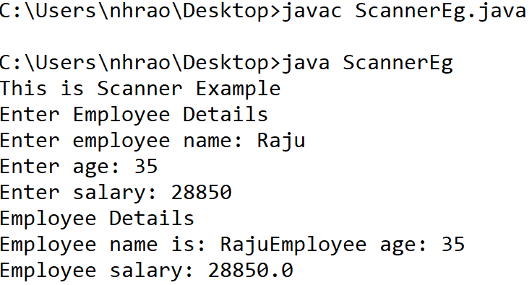
Example
import java.util.*;
class ScannerEg {
public static void main(String args[]) {
String str = "Scanner Example";
Scanner sc = new Scanner(str);
System.out.println("This is "+ sc.nextLine());
sc.close();
System.out.println("Enter Employee Details");
Scanner inp = new Scanner(System.in);
System.out.print("Enter employee name: ");
String empName = inp.next();
System.out.print("Enter age: ");
int age = inp.nextInt();
System.out.print("Enter salary: ");
double sal = inp.nextDouble();
System.out.println("Employee Details");
System.out.print("Employee name is: " + empName);
System.out.println("Employee age: "+ age);
System.out.println("Employee salary: "+ sal);
inp.close();
}
}

Slide 6
Date Class
The java.util.Date class represents date and time in java.
It provides constructors and methods to deal with date and time in java.
java.util.Date Constructors
No. | Constructor | Description
1) | Date() | Creates a date object representing current date and time.
2) | Date(long milliseconds) | Creates a date object for the given milliseconds since January 1, 1970, 00:00:00 GMT.

Slide 7
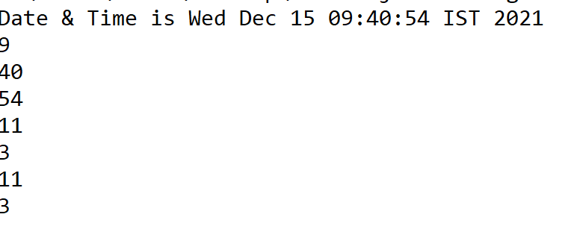
Example
import java.util.Date;
class DateEg
{
public static void main(String a[])
{
Date d=new Date();
System.out.println("Date & Time is "+d);
System.out.println(d.getHours());
System.out.println(d.getMinutes());
System.out.println(d.getSeconds());
//System.out.println(d.getYear());
System.out.println(d.getMonth());
System.out.println(d.getDay());
System.out.println(d.getMonth());
System.out.println(d.getDay());
}
}

Slide 8
java.util.Date Methods
No. | Method | Description
1) | boolean after(Date date) | tests if current date is after the given date.
2) | boolean before(Date date) | tests if current date is before the given date.
3) | Object clone() | returns the clone object of current date.
4) | int compareTo(Date date) | compares current date with given date.
5) | boolean equals(Date date) | compares current date with given date for equality.
6) | static Date from(Instant instant) | returns an instance of Date object from Instant date.
7) | long getTime() | returns the time represented by this date object.
8) | int hashCode() | returns the hash code value for this date object.
9) | void setTime(long time) | changes the current date and time to given time.
10) | Instant toInstant() | converts current date into Instant object.
11) | String toString() | converts this date into Instant object.

Slide 9
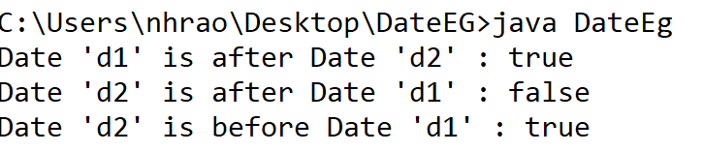
Before() & after() methods Example
import java.util.Date;
class DateEg
{ public static void main(String[] args)
{
Date d1=new Date(2018,9,21);
Date d2=new Date(1997,3,10);
System.out.println("Date 'd1' is after Date 'd2' : "+d1.after(d2));
System.out.println("Date 'd2' is after Date 'd1' : "+d2.after(d1));
System.out.println("Date 'd2' is before Date 'd1' : "+d2.before(d1));
}
}

Slide 10
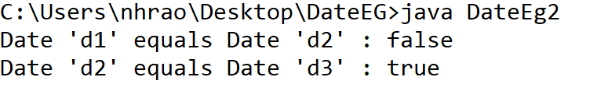
Date equals() Method
The equals() method of Java Date class returns a Boolean value on the basis of compression between two dates for equality.
import java.util.Date;
public class DateEg2{
public static void main(String[] args) {
Date d1=new Date(2018,9,21);
Date d2=new Date(1997,3,10);
Date d3=new Date(1997,3,10);
System.out.println("Date 'd1' equals Date 'd2' : "+d1.equals(d2));
System.out.println("Date 'd2' equals Date 'd3' : "+d2.equals(d3));
}
}

Slide 11
compareTo() Method
The compareTo() method of Java Date class compares two dates and sort them for order.
Return
It returns the value 0 if the argument Date is equal to this Date.
It returns a value less than 0 if this Date is before the Date argument.
It returns a value greater than 0 if this Date is after the Date argument.
Exception
NullPointerException will be thrown if anotherDate is null.

Slide 12
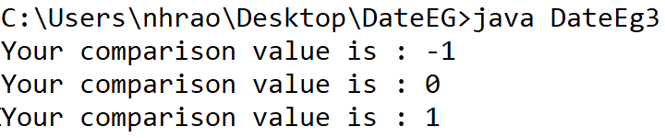
Example:
import java.util.Date;
public class DateEg3{
public static void main(String[] args) {
Date d1=new Date(1997,3,10);
Date d2=new Date(2018,9,21);
Date d3=new Date(2018,9,21);
Date d4=new Date();
int comparison=d1.compareTo(d2);
System.out.println("Your comparison value is : "+comparison);
comparison=d2.compareTo(d3);
System.out.println("Your comparison value is : "+comparison);
comparison=d3.compareTo(d4);
System.out.println("Your comparison value is : "+comparison);
}
}

Slide 13
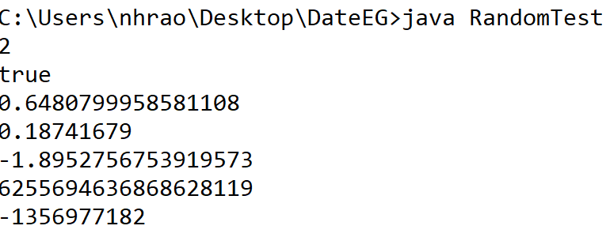
Java.util.Random class in Java
Random class is used to generate pseudo-random numbers in java.
import java.util.Random;
public class RandomTest
{
public static void main(String[] args)
{
Random random = new Random();
System.out.println(random.nextInt(10));
System.out.println(random.nextBoolean());
System.out.println(random.nextDouble());
System.out.println(random.nextFloat());
System.out.println(random.nextGaussian());
System.out.println(random.nextLong());
System.out.println(random.nextInt());
}
}

Slide 14
Calendar class Example
// Date getTime(): It is used to return a
// Date object representing this
// Calendar's time value.
import java.util.*;
public class Calendar1 {
public static void main(String args[])
{
Calendar calendar = Calendar.getInstance();
System.out.println("The Current Date is:" + calendar.getTime());
// Demonstrate Calendar's get()method
System.out.println("Current Calendar's Year: " + calendar.get(Calendar.YEAR));
System.out.println("Current Calendar's Day: " + calendar.get(Calendar.DATE));
System.out.println("Current MINUTE: " + calendar.get(Calendar.MINUTE));
System.out.println("Current SECOND: " + calendar.get(Calendar.SECOND));
int max = calendar.getMaximum(Calendar.DAY_OF_WEEK);
System.out.println("Maximum number of days in a week: " + max);
max = calendar.getMaximum(Calendar.WEEK_OF_YEAR);
System.out.println("Maximum number of weeks in a year: " + max);
int min = calendar.getMinimum(Calendar.DAY_OF_WEEK);
System.out.println("Minimum number of days in week: " + min);
min = calendar.getMinimum(Calendar.WEEK_OF_YEAR);
System.out.println("Minimum number of weeks in year: " + min);
calendar.add(Calendar.DATE, -15);
System.out.println("15 days ago: " + calendar.getTime());
calendar.add(Calendar.MONTH, 4);
System.out.println("4 months later: " + calendar.getTime());
calendar.add(Calendar.YEAR, 2);
System.out.println("2 years later: " + calendar.getTime());
}
}

Slide 15
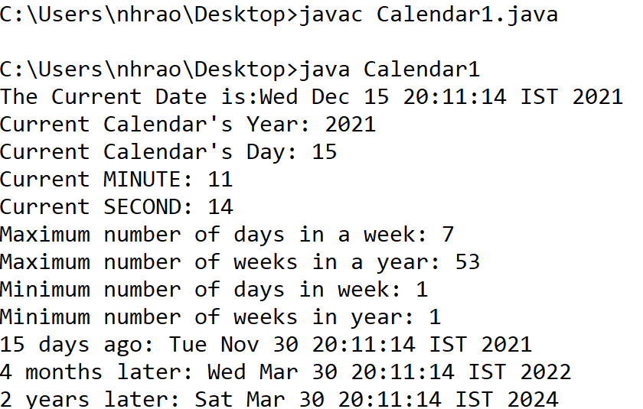
output

